Slide 1
Regional Economic Update
2022 Real Estate Outlook
North County Economic Development Council
Presented by Chief Economist, Ray Major
February 16, 2022
Notes:
The San Diego region is a place focused on the future. Situated on the southwestern corner of the continental United States, it is a focal point of international trade; the U.S. Navy’s most strategic port and home to the nation’s largest military community; a tourism mecca; and a center for innovation in telecommunications, biotechnology, and other high-tech fields. Its robust economy makes the region a popular place with employers and employees alike. As it approaches mid-century, the San Diego region faces challenges common to many urban areas – congestion, a housing shortage and economic inequities, and environmental impacts associated with climate change. To capitalize on new economic opportunities in coming decades, the region must meet these challenges and overcome them. Investing in the San Diego region has yielded huge returns in the past, and investing in its future will no doubt do the same – opening up new horizons for prosperity in the 21st century.
The San Diego region has a rich heritage rooted in familial, cultural, linguistic, culinary, and educational connections between people on both sides of the border. Over the last century, economic and social progress was advanced as a result of deliberate decisions by real people in distinct moments. These visionaries imagined what our region’s future could become, long after they had passed on. The attributes that make our region a beautiful and dynamic place to live, work, and raise a family are the result of people who embraced our region’s potential.

Slide 2
COVID-19 is Driving the Regional Economy

Slide 3
COVID-19 is Driving the Regional Economy
COVID Variants
Labor Force Disruptions
Unemployment Rate 4.2% (December 2021)
Record Job Openings
Record Resignations
Inflation
PPI up 9.8% last 12 months
Core CPI up 6.0% last 12 months
Housing Prices
$825k median home price
Housing prices are up 24% since last year (October)
Mortgage Interest rates approximately 3.1%

Slide 4
CPI & PPI: YoY % Change
9.8%
7.5%
6.0%
Source: U.S. Bureau of Labor Statistics
Notes:
All figures are seasonally adjusted
CPI: Core = Consumer Price Index for All Urban Consumers: All Items Less Food and Energy in U.S. City Average
CPI: Headline = Consumer Price Index for All Urban Consumers: All Items in U.S. City Average
PPI: Final Demand = Producer Price Index by Commodity: Final Demand

Slide 5
Inflation by Category (Dec 2020 to Dec 2021)
Source: U.S. Bureau of Labor Statistics
Notes:
Source: BLS

Slide 6
“Shrinkflation”
Current
Shrinkflation
11% Less Product
Same Price
Pre-Pandemic
Notes:
Economists have long noted that inflation can be overstated because it often doesn’t account for technological or quality improvements (cars, computers, phones, music services) that make the “same” items better.
But the reverse can also be true, especially in times of supply or worker shortage.
“Shrinkflation” is the practice of making the “same” product smaller without lowering the price. Classic example: candy bars. Others: “half gallon” of ice cream is probably 1.5 quarts, a quart of Gatorade is 28 oz, cereal boxes, toilet paper rolls.

Slide 7
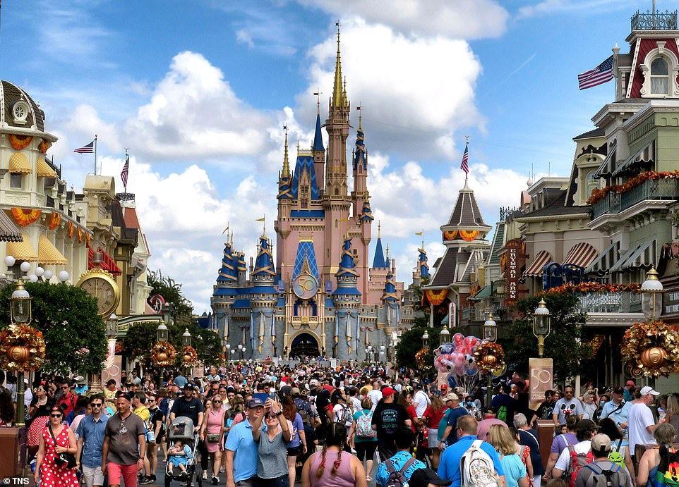
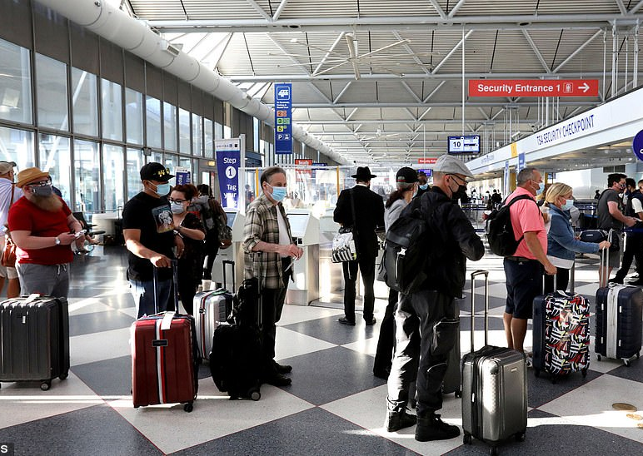
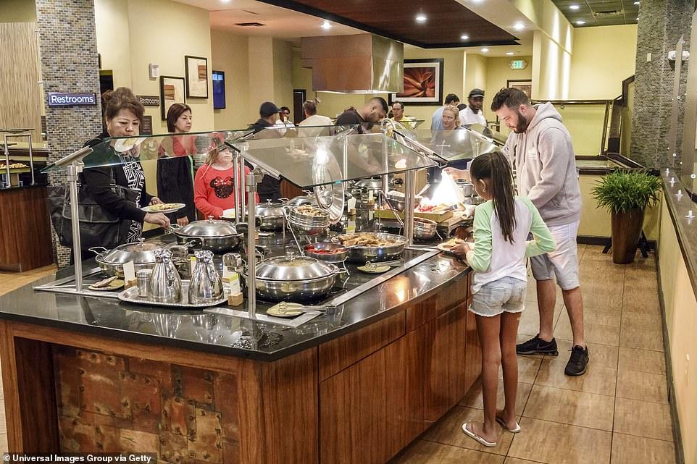
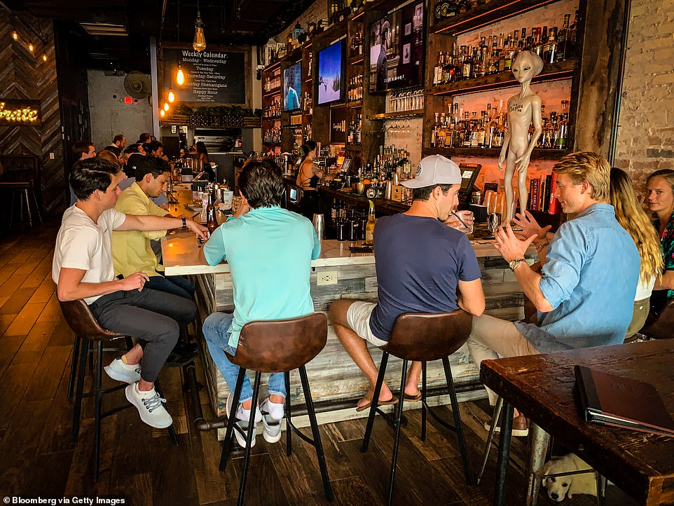
Skimpflation
Reduced Services
Longer lines
Longer wait times
Reduced staffing levels
Elimination of perks
Notes:
“Skimpflation” is when a business stops providing a service but doesn’t lower prices, often due to staffing issues. Examples: missing hotel breakfasts, “fast casual” dining without waitstaff, Disneyland understaffing extending wait times and reducing tram services to parking lots (Disney has always understaffed, carefully measures how much inconvenience guests will tolerate; if you go to Disney, you are consenting to be treated like livestock).
Not all businesses can pass along cost increases, and especially small businesses are struggling to control costs and keep staff.

Slide 8
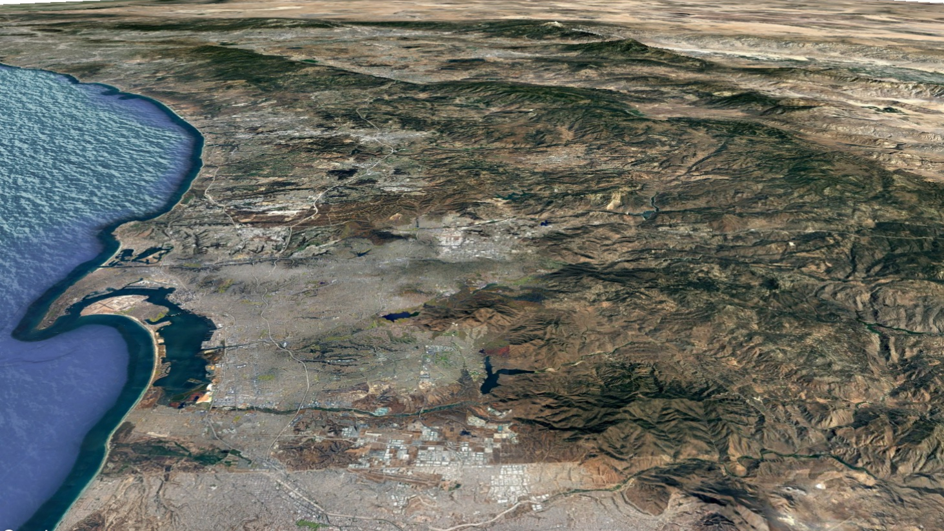
Supply Chain

Slide 9
Supply Chain Chaos Driving Inflation Bottlenecks in every link of the supply chain
Production
Covid shutdowns
Worker shortages
Lack of raw materials and components
Energy cost increases
.
Global Shipping
Shipping suddenly stopped then restarted; ships diverted to deliver personal protective equipment and essential goods.
Ports
Sudden shifts in volume
Worker/trucker shortage
Shortage/surplus of containers
Notes:
Supply side, “Lean” supply chains have become the norm – efficient but not resilient. Challenges at every point:
Production – Covid shutdowns, worker shortages, lack of raw materials and components, energy costs.
Global Shipping – Shipping suddenly stopped then restarted; ships diverted to deliver PPE and essential goods.
Ports – Sudden shifts in volume, worker/trucker shortage, shortage/surplus of containers.
Bottlenecks in every link of the supply chain.
“Lean” or “just-in-time” supply chains reduce warehousing costs by reducing inventories, but require reliable manufacturing and shipping. They are efficient but not resilient.
Manufacturers and distributors of goods cannot produce or supply as much as they did pre-pandemic for a number of reasons: worker shortages, lack of components and raw materials, cost increases, power shortages in China and energy cost rising elsewhere.
Global shipping halted and then restarted, with many ships diverted off usual routes to deliver PPE and other essential items. Return to normalcy is difficult. The backup of cargo ships heading toward Long Beach and Los Angeles is so bad that you can now see vessels waiting off the coast of San Diego. 90-100 ships waiting to get into ports.
Ports having difficulties: laid off workers, now need more. Space limited. Containers in the wrong places.

Slide 10
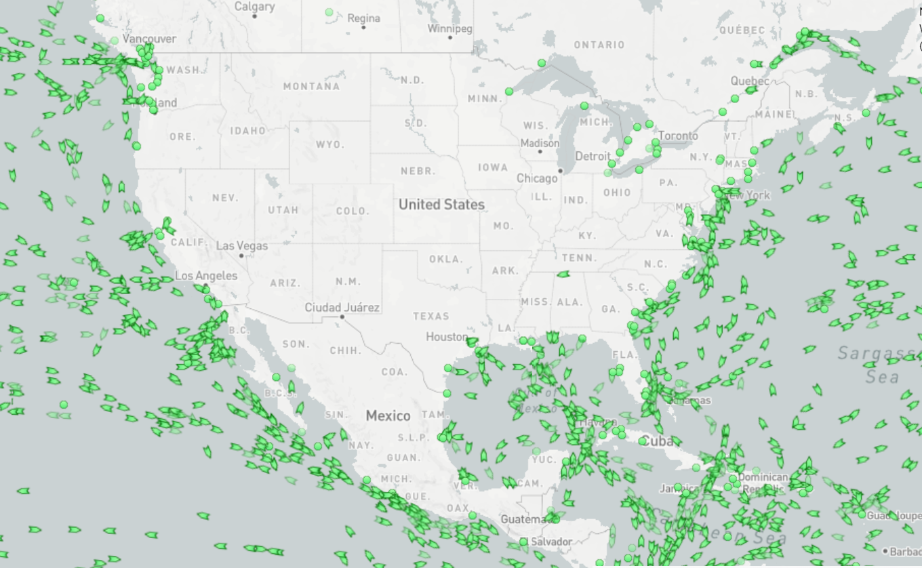
Container Ships Stuck in Traffic at Ports
Source: February 14, 2022 https://www.marinetraffic.com/en/ais/home/centerx:-98.6/centery:34.0/zoom:4
Notes:
jampacked container ships are stuck in traffic at ports, which is choking the economy. Delayed containers have become both a symptom of and a contributor to global supply chain problems.
Supply side, “Lean” supply chains have become the norm – efficient but not resilient. Challenges at every point:
Production – Covid shutdowns, worker shortages, lack of raw materials and components, energy costs.
Global Shipping – Shipping suddenly stopped then restarted; ships diverted to deliver PPE and essential goods.
Ports – Sudden shifts in volume, worker/trucker shortage, shortage/surplus of containers.
Bottlenecks in every link of the supply chain.
“Lean” or “just-in-time” supply chains reduce warehousing costs by reducing inventories, but require reliable manufacturing and shipping. They are efficient but not resilient.
Manufacturers and distributors of goods cannot produce or supply as much as they did pre-pandemic for a number of reasons: worker shortages, lack of components and raw materials, cost increases, power shortages in China and energy cost rising elsewhere.
Global shipping halted and then restarted, with many ships diverted off usual routes to deliver PPE and other essential items. Return to normalcy is difficult. The backup of cargo ships heading toward Long Beach and Los Angeles is so bad that you can now see vessels waiting off the coast of San Diego. 90-100 ships waiting to get into ports.
Ports having difficulties: laid off workers, now need more. Space limited. Containers in the wrong places.

Slide 11
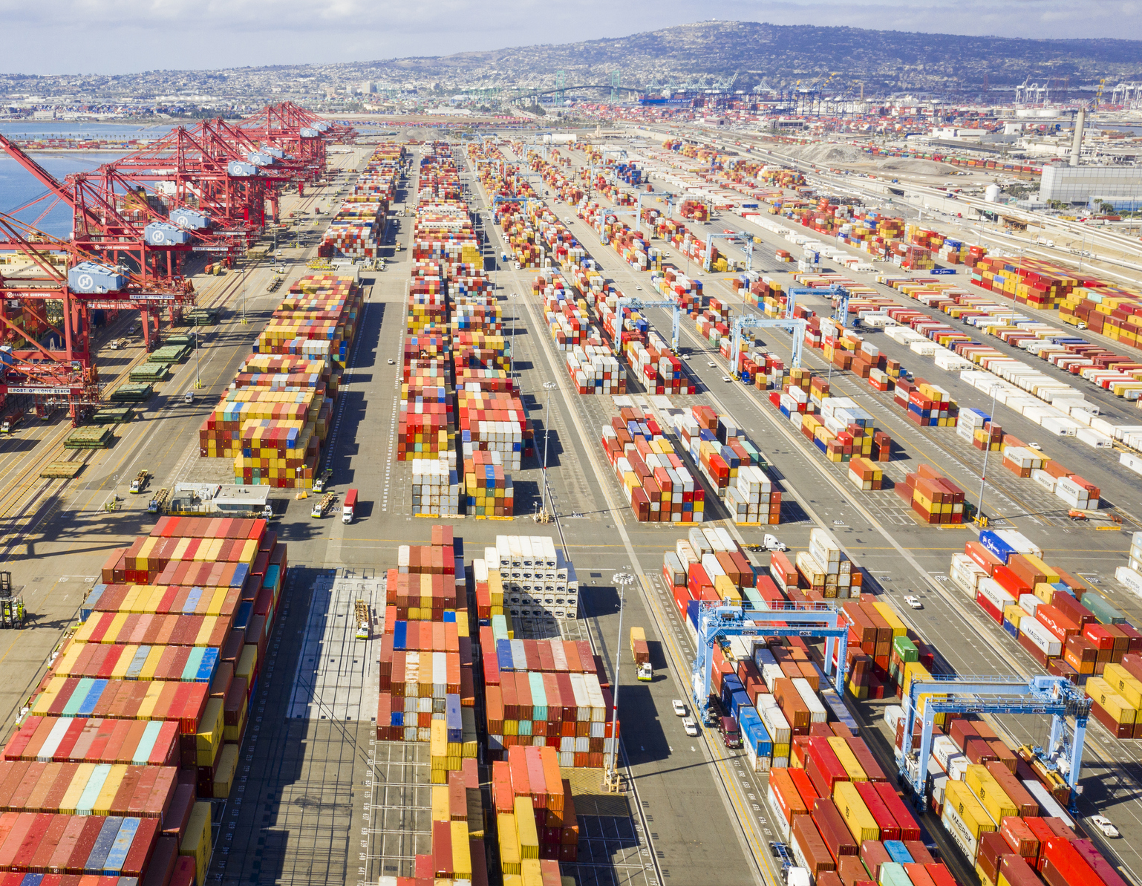
Supply Chain Backlog at Ports: 100+ ships 80,000 Truck Drivers ???? Price Increases Record High Demand Panic Buying / Hoarding Food Shortages

Slide 12
Labor Force

Slide 13
Employment During Recessions San Diego Region
Source: U.S. Bureau of Labor Statistics

Slide 14
Hardest Hit Sectors San Diego Region (Feb 2020 – Dec 2021)
68,200 total job loss
46,600 or 68% of total job loss fell into tourism, education, and professional services
Source: SANDAG Estimates based on Employment Development Department Labor Market Information Division data
Notes:
Tourism = Jobs like restaurant servers and hotel housekeepers
Professional Services = jobs like Finance and Real Estate like Realtors
Education = jobs like teachers includes people who provide training and instruction. Education sector also includes “educational support services" which capture people primarily engaged in providing noninstructional services that support educational processes or systems (IE: vocational rehabilitation counselors, education testing services, study abroad programs, etc)
Support staff who work at schools fall under different sectors.
https://www.census.gov/naics/?input=61&year=2017&details=61
New Data: Generated by the Unemployment estimates python script: unemployment_sectors_monthly_estimates
Old Data: https://sandag.sharepoint.com/:x:/s/Economicanalysistemp/ES8MQJMprylNoz28f26X6OcBkNVvQne3jTzvo7DxJKAreg?e=4%3ARvknGC&web=1&at=9&CID=5a3de886-4aac-bf66-ae30-2f154031c448 – in the chart sheet

Slide 15
COVID-19 Impact on workforce participation
 | Alpha | Gen Z | Millennials | Gen X | Boomers | Traditionalists
Years Born: | 2020-2007 | 2006-1996 | 1995-1978 | 1977-1966 | 1965-1946 | Pre-1945
Age Range: | 0-15 | 16-26 | 27-44 | 45-56 | 57-66 | 67+
Life Cycle: | n/a | Entry Level | Core Workforce` | Managers | Executives | Institutional knowledge
Work is: | n/a | Constantly evolving | A means to an end | A difficult challenge | Expected | An Obligation
Motivation: | n/a | Structure and stability | Freedom and Flexibility | Work-Life Balance | Job Security | Home Ownership
Changing Jobs: |  | Constantly | Is expected | If necessary for compensation | Loyal to employer Connect to values | Stay for life
No / Virtual Experience
Great Resignation
Early Retirement
Retirement
2020
2030

Slide 16
North County Economic Development Council Statistics

Slide 17
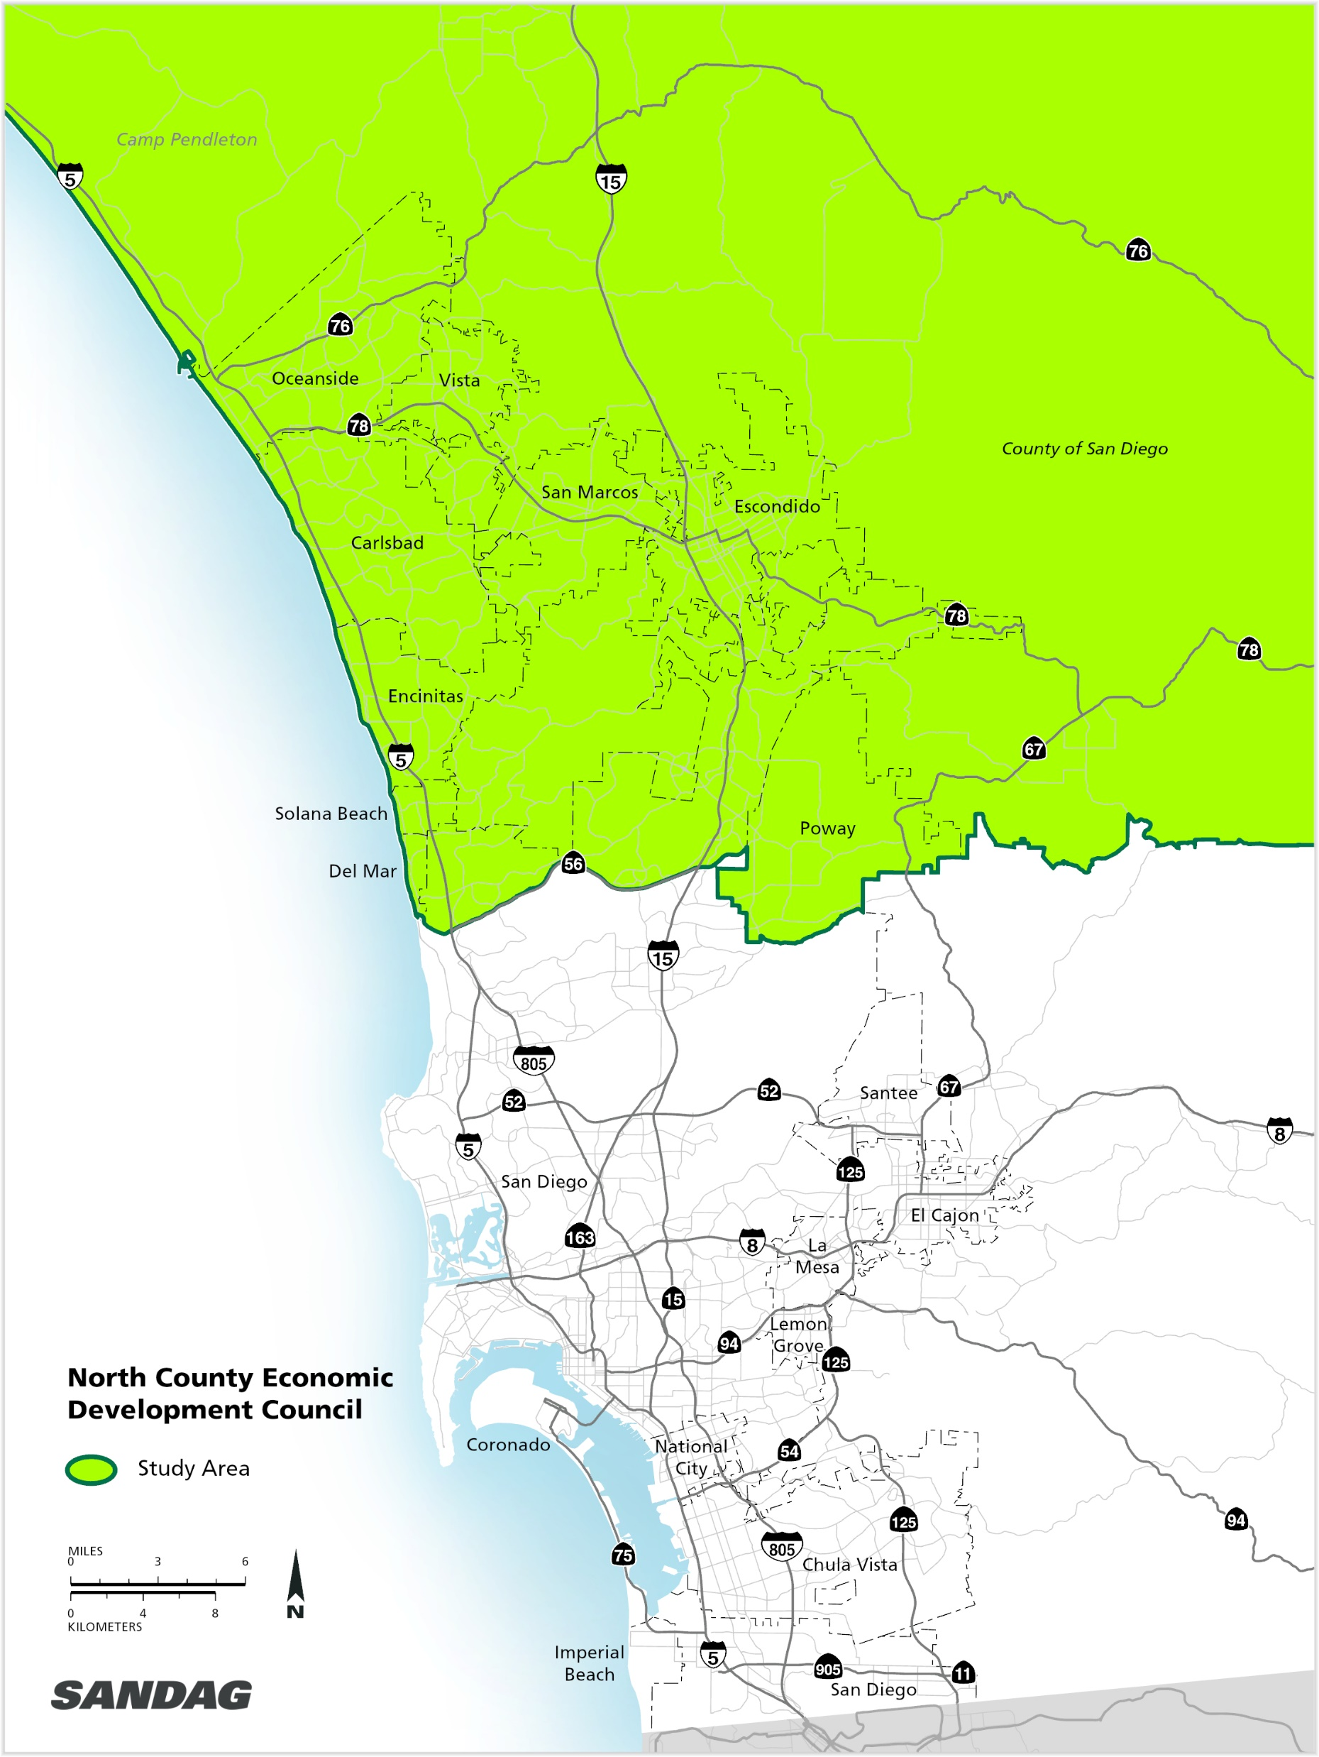
North County Overview
1,204,331
total population
36% of SD Region
438,336
jobs
30% of SD Region
429,205
housing units
35.3% of SD Region
53% white
30% hispanic
17% other
35-39 median age range
$75,000 - $99,000 median household income range
43%
have a
bachelor’s
degree or
higher
Source: ACS 2019 5-year estimate, LEHD 2018, SANDAG Census estimates
Source: ACS 2019 5-year estimate, LEHD 2018, SANDAG Census estimates
Notes:
Non-Hispanic, White 53.15%
Hispanic 29.84%
Non-Hispanic, Asian 9.76%
Non-Hispanic, Two or More Races 3.30%
Non-Hispanic, Black 2.73%
Non-Hispanic, American Indian or Alaska Native 0.56%
Non-Hispanic, Hawaiian or Pacific Islander 0.43%
Non-Hispanic, Other 0.23%

Slide 18
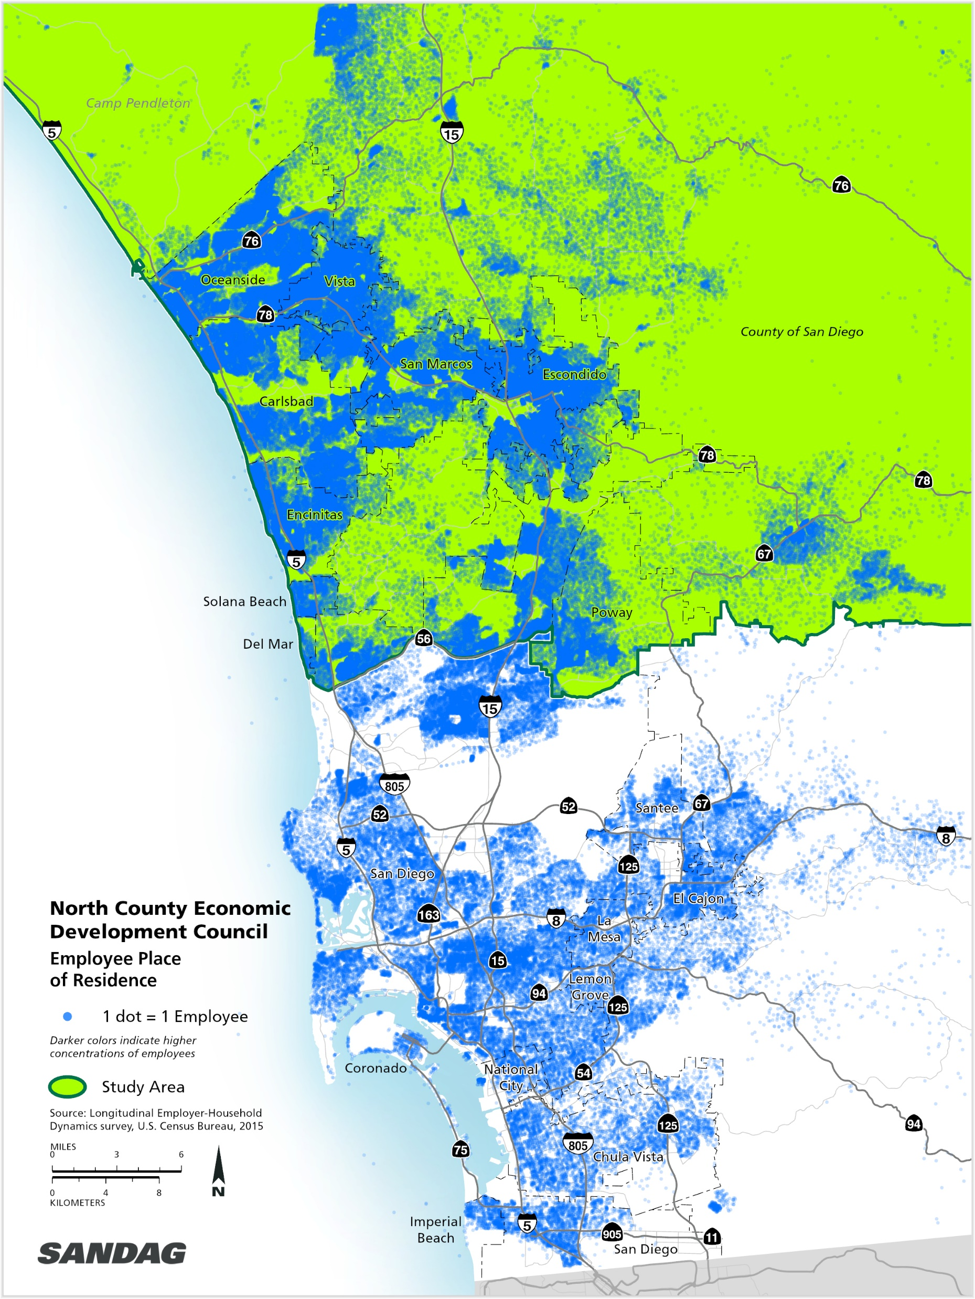
Where NCEDC Workers Live
438,336
245,373
192,963
workers (jobs) (30% of the San Diego region)
(56%) of NCEDC workers also live in NCEDC
(44%) of NCEDC workers live outside of NCEDC
Source: LEHD 2018

Slide 19
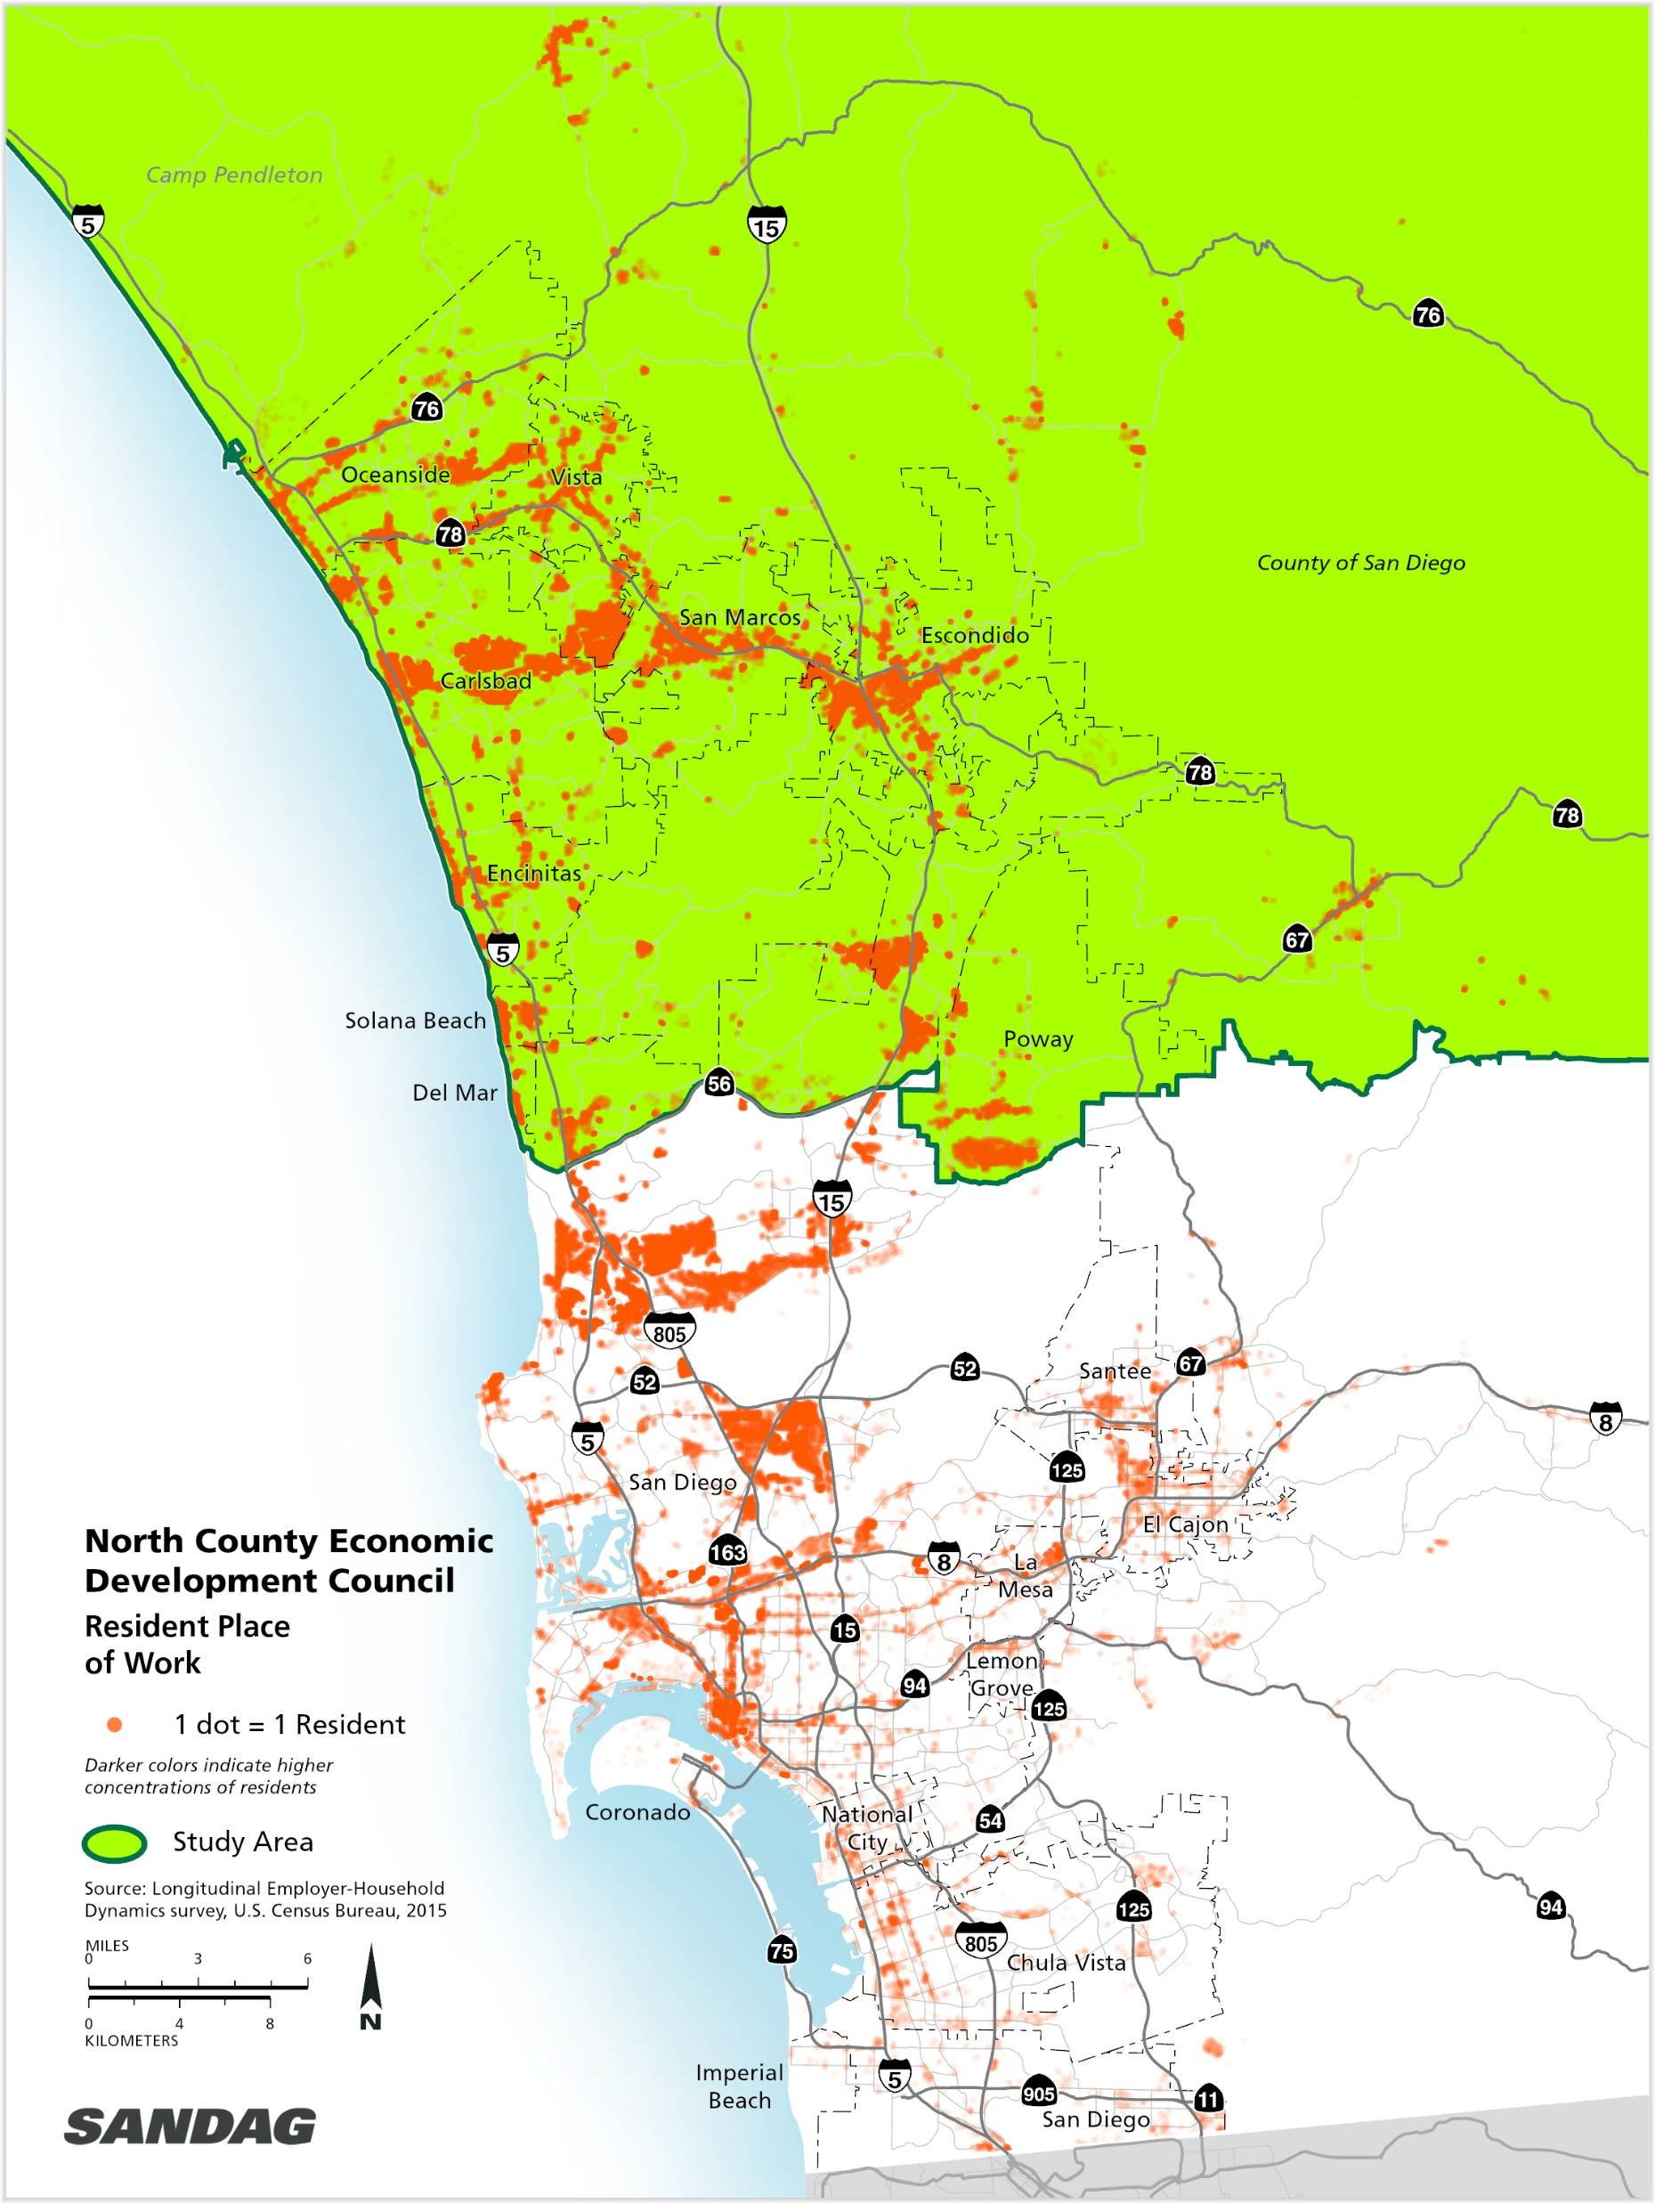
Where NCEDC Residents Work
488,046
245,373
242,673
employed residents (33.5% of the San Diego region)
(51%) of NCEDC residents also work in NCEDC
(49%) of NCEDC residents work outside of NCEDC
Source: LEHD 2018

Slide 20
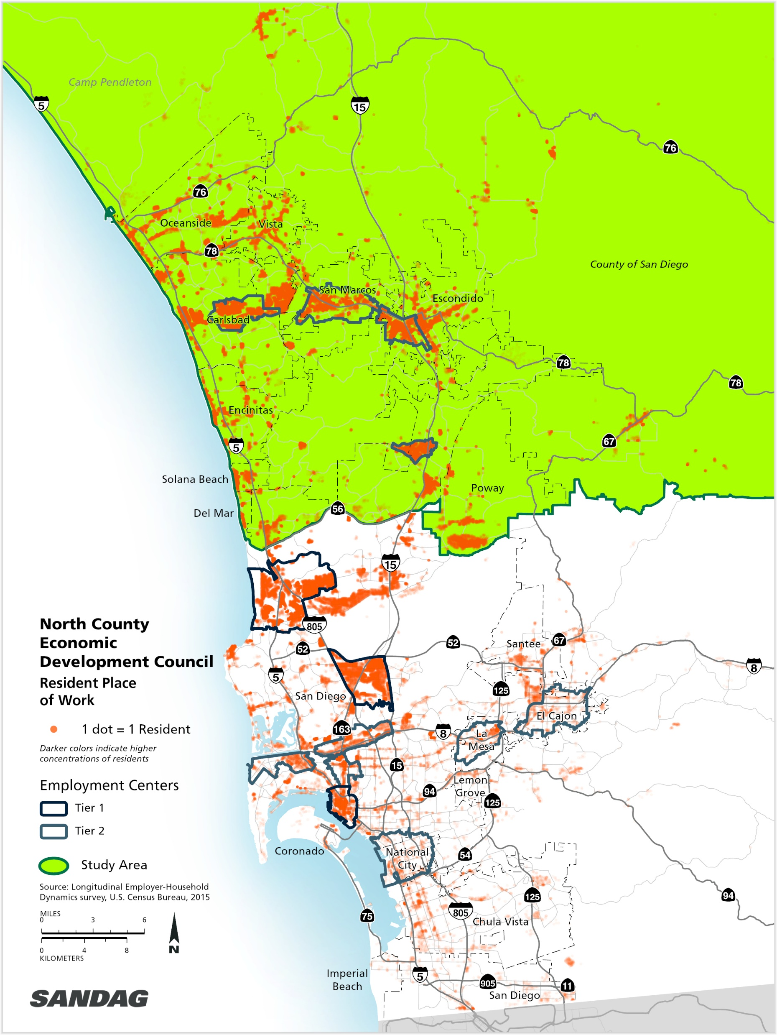
Where NCEDC Residents Work
438,336
488,046
28%
workers (jobs) in NCEDC
employed residents in NCEDC
of NCEDC residents work in
Tier 1 and Tier 2 Employment Centers
20,000
20,000
19,000
work in Carlsbad Palomar Airport (4.1%)
work in Sorrento Valley West (4.0%)
work in
San Marcos Civic Center (3.8%)
Source: LEHD 2018

Slide 21
Population & Housing Growth and Mobility Hub Coverage

Slide 22
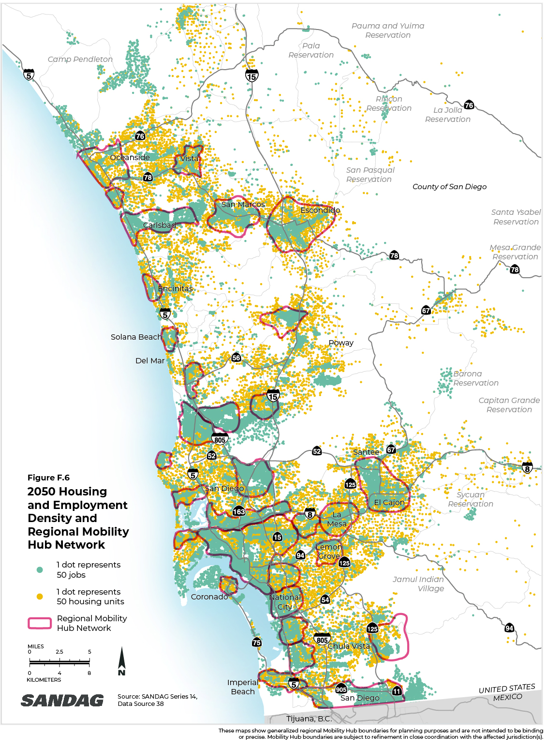
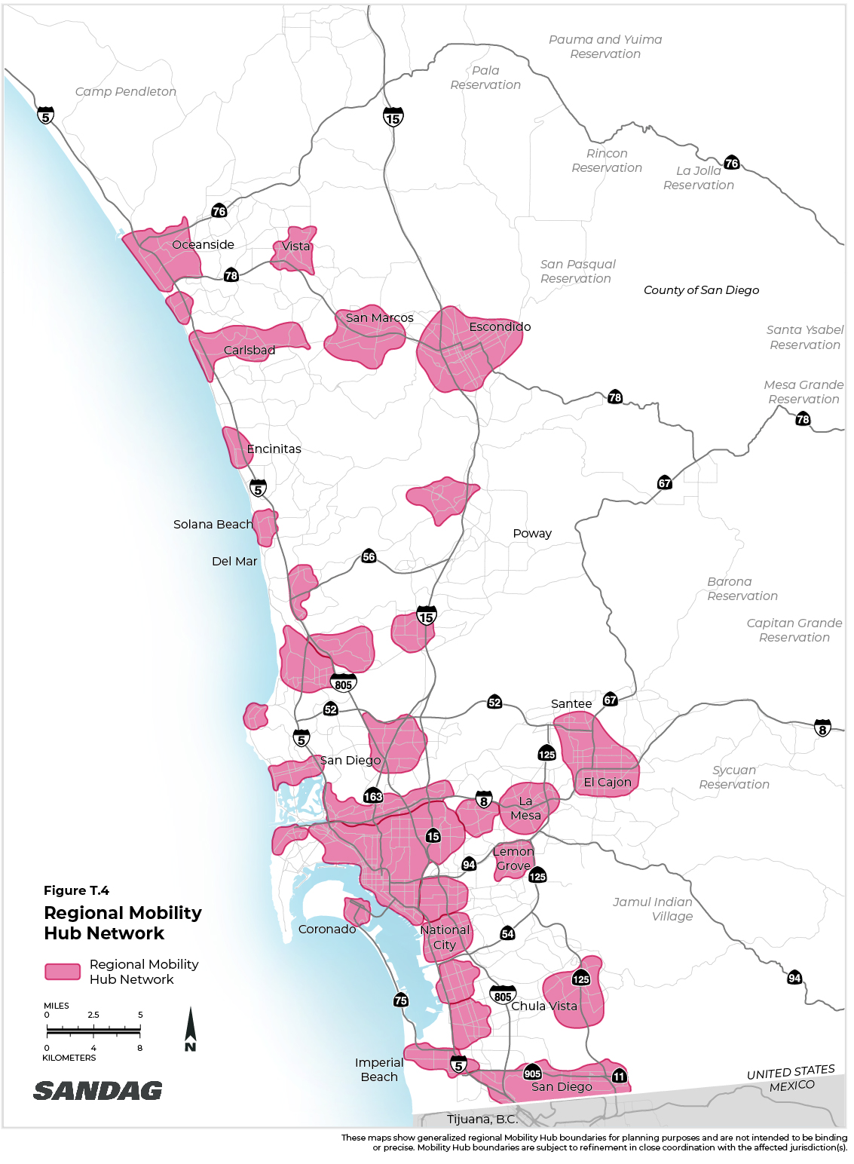
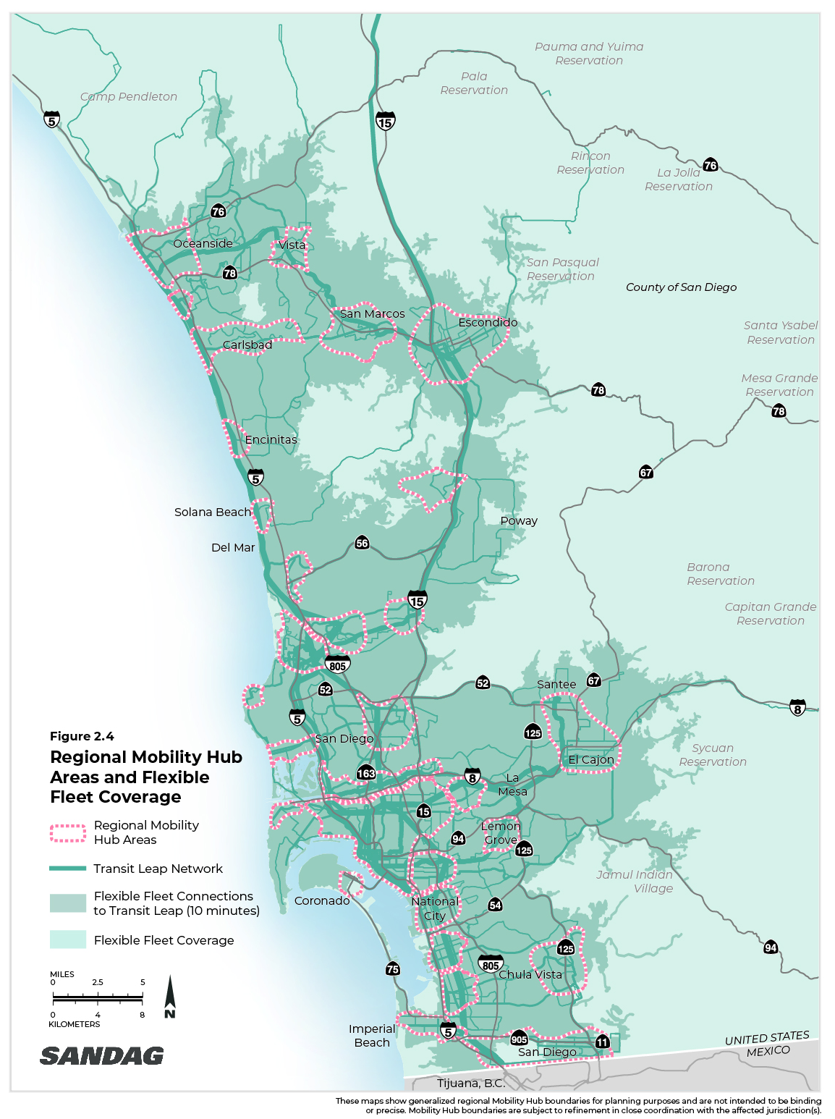
Mobility Hubs

Slide 23
What to Expect in 2022
COVID-19 continues to drive the economy
Slowing rates of inflation, but still high given recent history
Continued labor force disruptions – resignations, unemployment, job openings
Sharp increases in wages
Businesses continue to struggle
Housing prices continue to stay high – interest rates stay low
Reduction in disposable personal income resulting in reduction in standard of living
Continued federal intervention

Slide 24
Stay connected with SANDAG
Explore our website
SANDAG.org
Follow us on social media: @SANDAGregion @SANDAG
Email: ray.major@sandag.org

