Slide 1
2024 Tax Update
Jessica Dorsett and April Kriz
Magnus Blue LLP

Slide 2
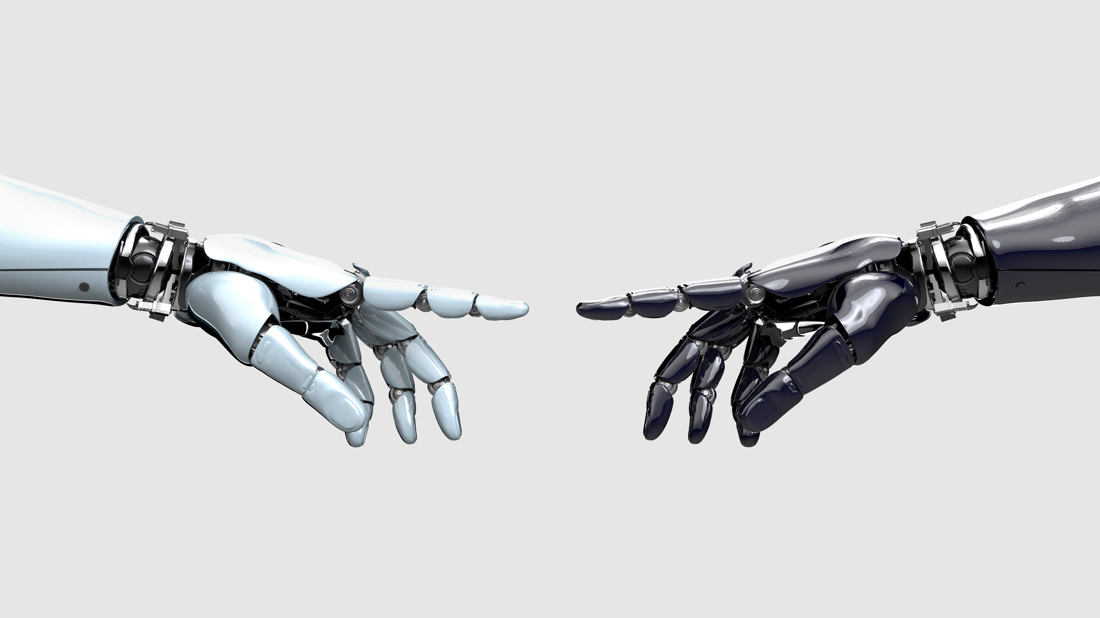
Research And Experiment
Pre-2022
All R&E expenses were deducted when incurred or paid
No capitalization requirements; but if capitalized, subsequent disposals were taken as losses if applicable
R&D credit available with very little documentation/reporting requirements
Beginning with tax years after 12/31/21
All “specified research or experimental (SRE) expenditures” must be capitalized and amortized over 5 yrs (if US) or 15 yrs (if foreign); 1st year is mid-yr amort.
When disposed, no write off – keep amortizing
R&D credit still available, but possible limit to amortization
Starting 1/10/25 - Any R&D credit amendments to prior years requires add’l info and sworn declaration

Slide 3
Example 1st year calculation:
SRE Expenditures incurred during the year $630,000
Amortization period ÷ 60
Monthly deduction 10,500
Deductible months in 1st year X 6
Amortization deduction in 1st year $ 63,000

Slide 4
SRE Expenditures
Included:
Labor costs (perform, supervise, or directly specified research activity)
Contractors
Cost of materials
Cost recovery allowances (such as depreciation of property used in SRE)
Certain overhead allocations
Travel costs
Excluded:
G&A
Interest of debt financing
Website costs
Amortization of SRE
QC testing
Patent, product, model or process acquisition costs
Advertising
Etc.

Slide 5
Employee Retention Credit
IRS Paused Processing New Claims on 9/14/23
Deadline to file claims is 4/15/24 (2020 tax year)
Improper ERC claims – IRS is developing a redraw program and settlement program to self-report
“Reasonable Cause” Penalty relief available on incomes taxes owed for amended 2020 & 2021 tax returns for ERC – must request (interest not eligible)
Reminder – not taxable to CA (only time CA should be amended is for sole-proprietors – sch. C)

Slide 6
Bonus depreciation or sect. 179 expense
Bonus Depreciation
Section 179 Expense
2023 calendar year – limited to 80%
2024 calendar year – limited to 60%
2025 – 40%; 2026 – 20%; 2027 – 0%
Should be taken before section 179 expense
2023 tax year – max $1,160,000
2024 tax year – max $1,220,000
Caution – may not want to default to taking accelerated depreciation under certain circumstances

Slide 7
Excess Business Losses & Net Operating Losses
Excess Business Losses:
Net Operating Losses:
Applicable to passthrough entities only
Limits losses to $578k (2023 for joint filers)
Remaining amount carries forward as an NOL
Federal – can only offset 80% of taxable income in future years, remaining carries forward
No expiration (fed)

Slide 8
Qualified Commercial Clean Vehicles Credit
Credit equal to the lessor of
15% of the vehicle’s basis (30% if not powered by gasoline or diesel); or
The excess of the vehicle’s purchase price over the cost of a comparable vehicle in terms of size and use, which is powered solely by a gasoline or diesel internal combustion engine
Maximum credit $40,000
$7,500 - vehicles less than 14,000 pounds
Must be propelled to a significant extent by an electric motor that draws electricity from a battery with a min. capacity of 15 kilowatt hours (7 for vehicles that weigh less than 14,000 pounds) and is capable of being recharged from an external source; or
A fuel cell vehicle (defined)
Must be subject to depreciation (must capitalize)
Credit is subject to recapture if no longer qualified (i.e. not used in trade or business)

Slide 9
Energy Efficient Commercial Buildings Deduction
Taxpayer may deduct a portion of the cost to install energy efficient commercial building property (lease or own). Must be at least one of three systems:
Interior lighting system
HVAC system
The building’s envelope
Base calculation (up to $1/sq ft)
Bonus deduction if meet certain wage requirements and apprenticeship standards are met (up to $5/sq ft)

Slide 10
CA Passthrough Entity Elective Tax (PTE/PTET)
Work around the $10k SALT limitation for owners of passthrough entities (S-corporations and partnerships)
9.3% tax paid at entity level
Reduces federal ordinary income on K-1
CA tax credit on CA K-1 to owners
Not all owners have to participate – but caution should be exercised for S-corps
Doesn’t make sense for everyone; tax planning is necessary
For 2022, the first payment was due 6/15 to participate; remainder is due by 3/15
Caution: Cannot apply prior year refunds to next year payments

Slide 11
Multistate (Nexus)
States are becoming more aggressive in taxing out of state business
Possible triggers to taxation in other states:
Wages (remote workers)
Physical presence (office, sales team)
Revenues (service based industries – where are your customers?)
Sales of tangible items protected by Public Law 86-272 – for now
Each state is different (establishing nexus and how taxed not always the same)
Tax planning considerations

Slide 12
Beneficial Ownership Reporting
1/1/24 – New Businesses
1/1/25 – Existing Businesses
Reporting Requirements
Who must file – entities that register with the state Secretary of State (or similar agency)
What is reported: Ownership and certain related persons, officers, those who “exercise control” – need name, DOB, residential address, ID#, image of documents (ID cards, etc.)
Exempt: “Large operating companies” – 20+ full time employees, with US physical office, and filed federal income tax return with more than $5million in US gross receipts or sales
Certain listed industries
Recommendation – individuals to get own “FinCIN Identifier”
Due dates: 90 day grace period for 2024; 30 days after 12/31/24;
Initial filing; then update whenever there’s a change to the information

Slide 13
Unclaimed Property Reporting
Requirements: Must review records annual to determine if holding any funds, securities, or other properties that have been unclaimed for the required dormancy period. Wages must be surrendered to the state if not claimed by the employee within 1 year. Most other property is 3 years
Voluntary Compliance Program: www.sco.ca.gov/upd_vcp.html
Question on CA tax return – be sure to answer appropriately

Slide 14
Other Notes:
1.1% SDI tax - wage cap eliminated; can consider a self-insured plan
New Tax Credit for new 401k plans (100 employees or less)
Military spouse retirement plan eligibility credit for small employers

Slide 15
Thank you!
Jessica Dorsett, CPA
April Kriz, CPA
Jessica@magnusblue.com
April@magnusblue.com

